Slide 1
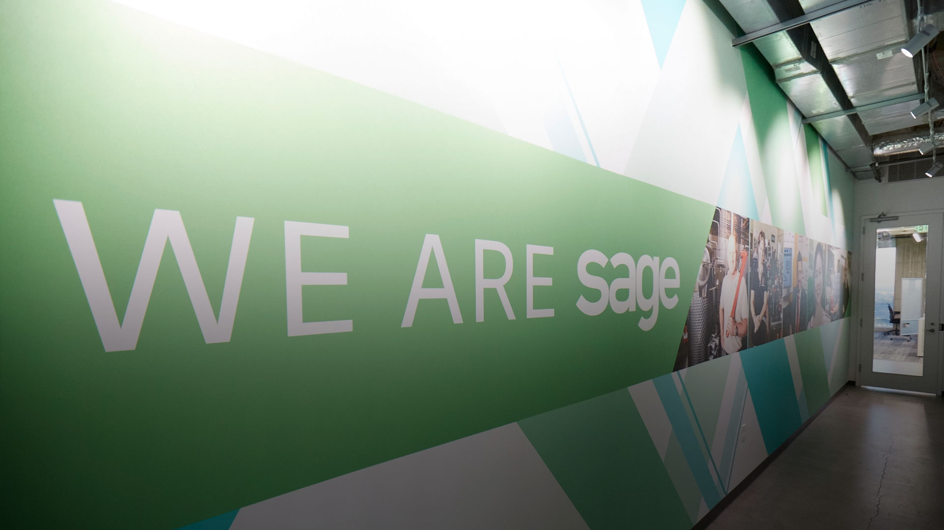

ProcessWeaver
Sales Training

Slide 2
Contents/Agenda
Partner Profile & Objectives
  Current relationship
Partner Solution
  Benefits & value proposition
  Demo
Sales benefits
Service and support
Q&A

Slide 3

ProcessWeaver
Current Relationship with Sage
ProcessWeaver Company Information:
Headquartered in Santa Clara, CA. With multiple locations in North America, Europe and India.
ProcessWeaver formed in 2006.
ProcessWeaver is 100% focused on Transportation Management System (TMS)
Tens of millions of orders shipped using ProcessWeaver Technology world-wide.

Slide 4
Why ProcessWeaver?
Business Analysts recognition as Notable Mention in Gartner’s Magic Quadrant for Transportation Management Systems in 2014, 2015, 2016, and 2017.
ProcessWeaver services multiple industries as Manufacturing, Retail, High Tech Wholesale/Distribution, Health and Medical, Life Sciences, e-Commerce, Energy, Electronics, and any industry that puts labels on boxes, boxes on trucks, planes, or ocean vessels.
In addition to both on-premise and cloud-base solutions, ProcessWeaver introduced mobile platforms that run on both iOS and Android platforms. ProcessWeaver is also one of the very few providers of shipping solutions that allows companies to manage inbound shipments from their suppliers.
24/7/365 Technical support.
ProcessWeaver’s TMS platform is modularly built and is strategically priced for market penetration with SAGE X3. (Enterprise)
ProcessWeaver’s strategic relationships includes UPS, FedEx, and other carriers, as well as providers of WMS, and TM products for added capability in logistics management. This includes Hazmat Shipping, Global Address Validation and packing optimization.
Highest Partner Certification with FedEx (Diamond) and UPS (UPS Select Ready). Support Canadian Carriers as well!!

Slide 5



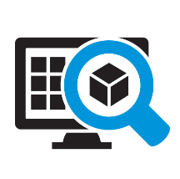


Where ProcessWeaver Can Fit In
ProcessWeaver TMS platforms helps business bring together technology and process improve to empower better transportation and logistics management. It operates as an extension of a company’s SAGE, WMS, CRM, and e-Commerce platforms to provide them with the ability to plan and execute their transportation. The following graphic represents how ProcessWeaver’s TMS technology is used by tens-of-thousands of shippers every day.
Pre-Fulfillment
Fulfillment
Post Shipment
Provide best way shipping options at time of Sales Order creation.
Box, skid, and container pack validation with information pulled from X3
Proactive track and trace of all shipments and updates on supply chain events, including Proof of Delivery (POD)
Shipping execution including weighing, rating, label and document printing, for parcel, LTL, TL, and Freight Forwarders, with information pulled from X3
Plan and route shipments in order to lower transportation costs
Enhanced supply chain visibility resulting in better customer service and internal inquires
Logistics data quality checks, such as address validation and denied parties screening
Single data repository for all information related to supply chain execution for reporting and BI
Updating X3 with freight cost and tracking information
Carrier tendering, pick-up and email notification to customer of shipment(s)
Receive carrier invoices electronically to enable freight auditing

Slide 6
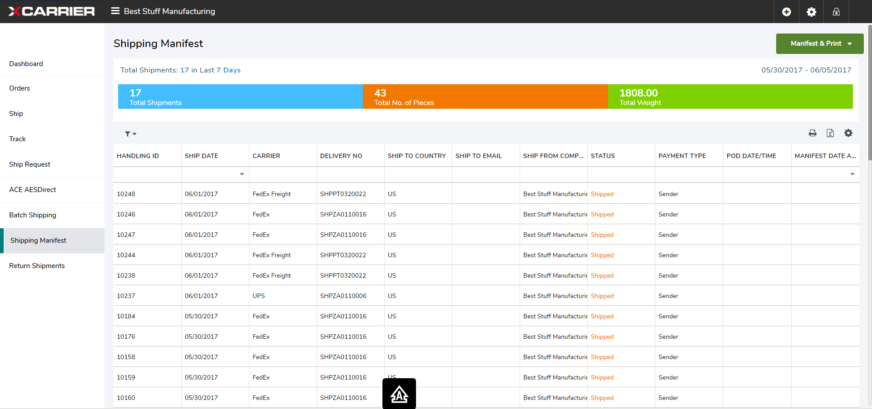
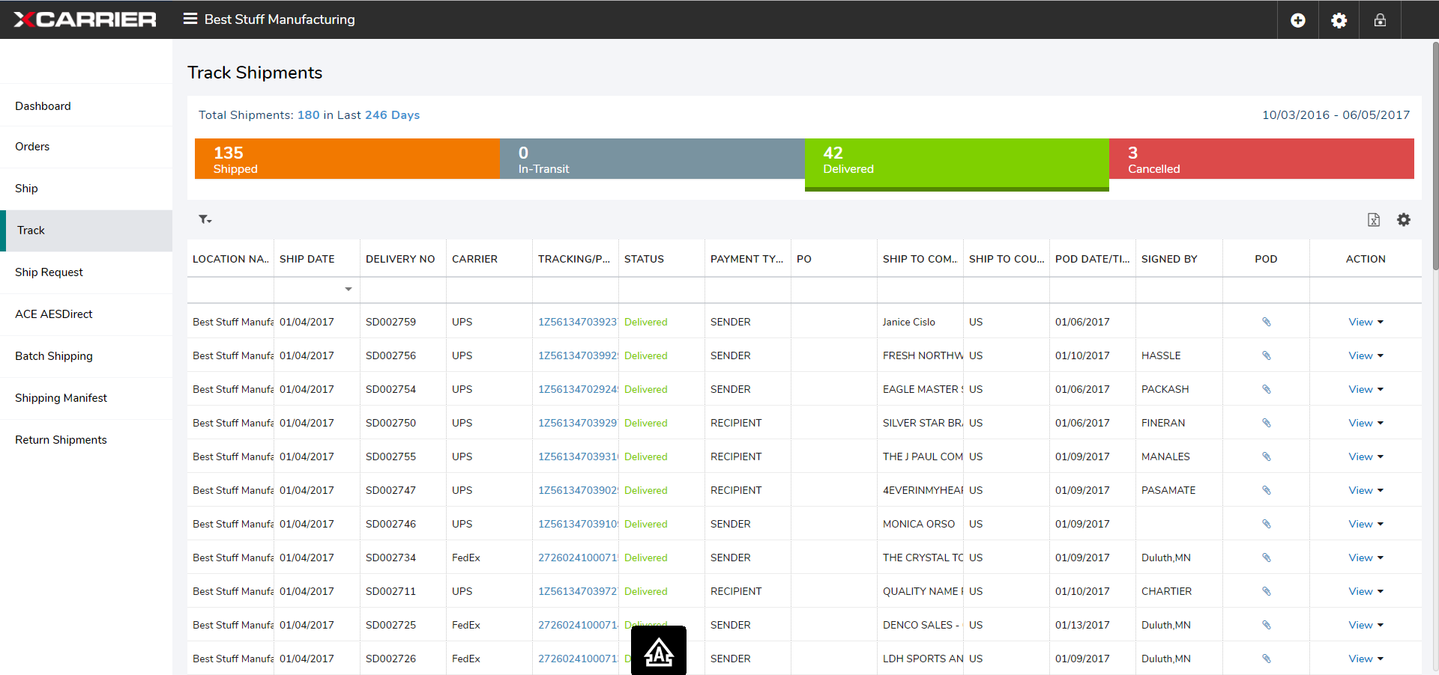
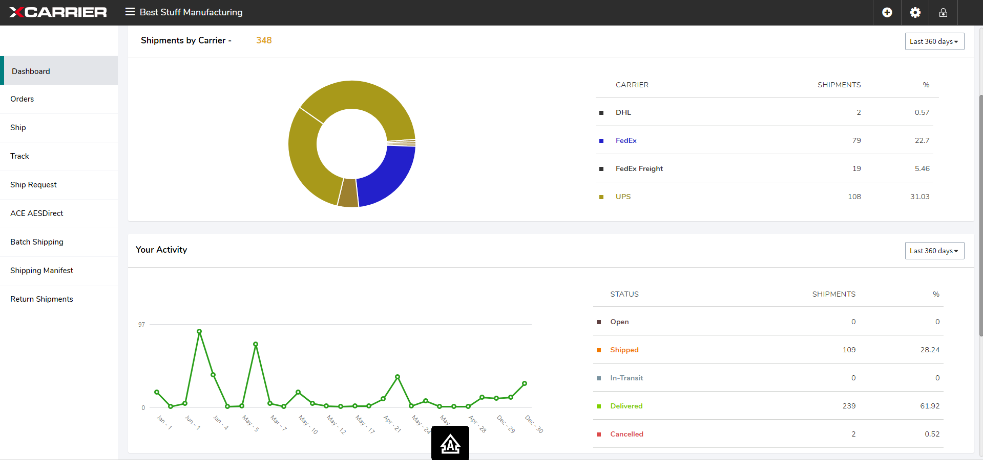
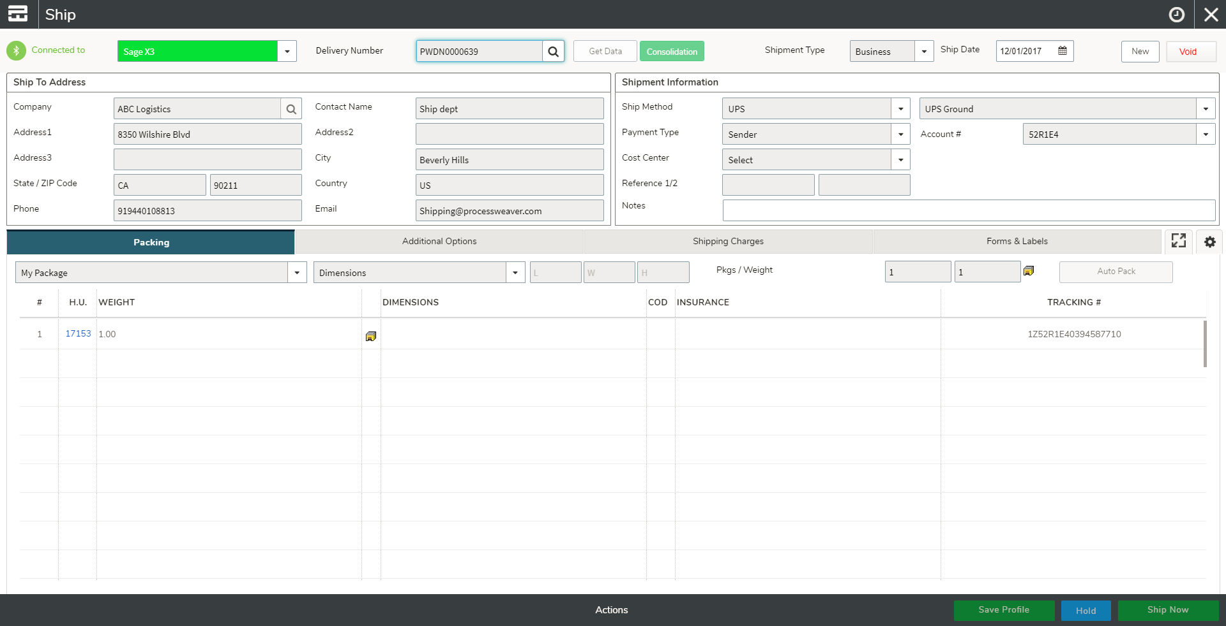
ProcessWeaver Demo

Slide 7
Competitive Differentiators
Sage relationship – ISV Rockstar
Global footprint with offices in North America, Europe, and India
ProcessWeaver technology used in over 80 countries to ship
200+ global carriers and logistics service provider – list continues to grow!
24/7 Technical Support
Key added capabilities – Rate Shop at Sales Order, Dangerous Goods Shipping, Freight Analytics.

Slide 8









Target customers
Manufacturing
Oil & Gas
Telecom and high tech
Automotive
Wholesale distribution
Transportation & logistics
retail
pharma
Food and beverage

Slide 9
Key Questions to uncover needs
Complexity – What modes of transportation do your use to ship your freight and how many locations do you ship from?
Shipping Volume – how many shipments do you get out the door on an average day for parcel, LTL, FTL, Freight Forwarders, etc.
Technology – what system or systems do your currently use to ship your orders?

Slide 10

Customer Value Proposition
Process improvement
Saving time
Saving money
VALUE
Helping to
make money
Providing valuable information
Making someone's day easier

Slide 11
Customer Value Proposition
1. Operational Efficiency
Reduce staffing requirements by automating the shipping and tracking of customer orders.
6. Visibility
2. Error Reductions
Enhance customer service by always knowing the status of all your shipments.
Eliminate costly shipping errors that are uncoverable and directly impact your customers.
VALUE
PROPOSITION
5. Reporting & Analytics
3.Transportation Spending
Use carrier shipping, tracking and billing information to measure performance .
Reduce transportation cost by avoiding selecting the wrong carrier.
4. IT Cost Reduction
Reduce staffing cost by 100s of hours each year maintaining external shipping systems.

Slide 12
How Does it Help You?
Sales Benefits
Talk with customers on Enterprise wide value chain to support SAGE Sales
Improve customers ROI.
Steam line workflow processes with SAGE X3 (Enterprise)
Add revenue to sales cycle
Single platform for Enterprise clients that have multiple locations / Domestic and International
Any customer that has a product needs to ship!

Slide 13
ProcessWeaver for X3 - Pricing
Bundled Modules: | Perpetual license SLP per location, USD | Perpetual license M&S
xCarrier TMS bundle | $9,500 | 20%
Includes:
Enterprise Centralized Shipping
Enterprise Track & Trace
Enterprise Address Validation
xCarrier TMS bundle with Rate Shopping | $18,500 | 20%
Includes:
Enterprise Centralized Shipping
Enterprise Track & Trace
Enterprise Address Validation
Enterprise Freight Shopping
Reverse logisitics
xCarrier TMS bundle with Analytics | $29,500 | 20%
Includes:
Enterprise Centralized Shipping
Enterprise Track & Trace
Enterprise Address Validation
Enterprise Freight Shopping
Global Trade EEI Link to AES Direct
Enterprise Freight Auditing/Analytics
Individual Modules: | Perpetual license SLP per location, USD | Perpetual license M&S
xCarrier Shipping Platform | $9,000 | 20%
Enterprise Freight Shopping | $7,000 | 20%
Enterprise Mobility Shipping | $11,000 | 20%
Enterprise Freight Auditing/Analytics | $18,000 | 20%
Global Trade EEI Link to AES Direct | $6,500 | 20%
Inbound Supplier Portal (For up to 50 Suppliers) | $15,000 | 20%
Hazmat Module | $9,500 | 20%
Notes:
1. Individual modules can be added to bundled modules.
2. Users are defined as users of the ProcessWeaver software only.
3. Perpetual licenses include unlimited users per location. A location is defined as one shipping point such as a distribution center, warehouse, office, or manufacturing plant.

Slide 14
Interested Prospect Next Steps
Sage identifies prospect or customer needs or gaps with their current transportation processes
ProcessWeaver will respond to survey with in 24 hours to help identify products, services and support to propose solution
ProcessWeaver will operate as an extension of Sage direct sales efforts to help win the opportunity
Identify Needs
Qualification
ProcesWeaver
Reponse
Engagement
Sales Assistance
What Next
Sage completes and remits a Qualification Survey to sage@processweaver.com
Sage will coordinate with ProcessWeaver additional discovery call and demonstrations
ProcessWeaver assists Sage in next steps to begin its part of the implementation

Slide 15
Implementation and Support
KICK-OFF MEETING
START / END
BLUE PRINT
START / END
DESIGN
START / END
INFRASTRUCTURE SETUP
START / END
DEVELOPMENT/CONFIG
START / END
INTEGRATION TESTING
START / END
PHASE 1 TRAINING
START / END
UAT PREP
START / END
UAT
START / END
FINAL TRAINING
START / END
GO-LIVE
START / END
HYPER-CARE SUPPORT
START / END
WEEK 1
WEEK 2
WEEK 3
WEEK 4
WEEK 5
WEEK 6
WEEK 7
WEEK 8
WEEK 9
WEEK 10
WEEK 11

Slide 16
On-Going Support
Partner/Customer Support
  End-User submits support request to Sage or Partner
  Partner or Sage provides initial diagnosis
  If ProcessWeaver, support request is submitted to ProcessWeaver
  ProcessWeaver works with Sage/Partner and end-user to identify and resolve support request
ProcessWeaver will provide support in multiple areas
- ProcessWeaver product-related issues
- ProcessWeaver and Sage integration-related issues
- End-user IT infrastructure-related issues

Slide 17
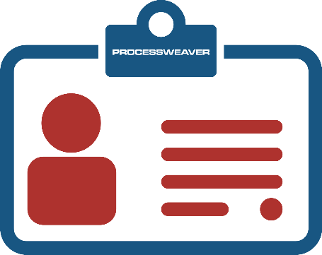
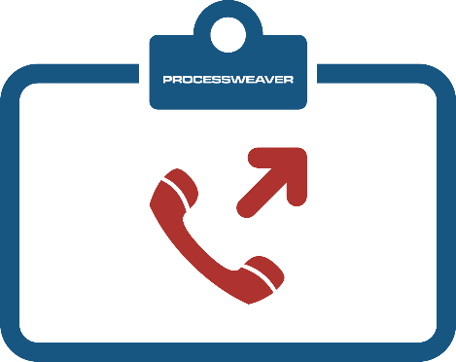
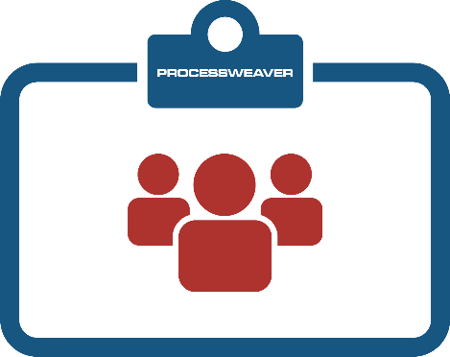

Support
ProcessWeaver online support portal enables our customers to create a ticket around the clock, provide issue details, and upload relevant documents. Our technical support team will acknowledge the ticket and respond according to the severity of the issue.
ProcessWeaver Support Portal
https://support.processweaver.com
Gain peace of mind with dedicated shipping experts that are available 24/7 to help resolve technical issues quickly.
24/7 Phone Technical Support
(888) 932-8373
Email is the means to reach us quickly from your computer or your mobile device. Our technical support team will acknowledge the email and respond according to the severity of the issue.
Email Technical Support
support@processweaver.com

Slide 18
Technical Support Response
Severity | Definition of Severity Levels | Maximum Response Time | Resolution Time
1 - Critical | The system is unable to be used for normal business activities. | 15 minutes | 1-3 hours
2 - Blocker | There is a problem with part of the system, which impacts on users decision making. No viable workaround is available. | Less than 1 hour | 4 hours
3 - Major | The efficiency of users is being impacted, but has a viable workaround. | Less than 2 hours | 24 hours
4 - Minor | A low impact problem that affects the efficiency of users but has a simple workaround. | Less than 8 hours | 72 hours
5 - Trivial | A fault, which has no particular impact on processing of normal business activities. | Less than 8 hours | 144 hours

Slide 19


Sales Collateral
xCarrier for Sage X3 Product Brochure
ProcessWeaver Company Brochure
xCarrier for Sage X3 Video
xCarrier for Sage Self-Running Video
Prospect Qualification Survey

